Slide 1
Stopping the Summer Slide
Language and Social Thinking Skills
Jennifer Wynn, M.A., CCC-SLP

Slide 2
My Background
SLP for 22 years
B-3, pre-k, elementary, middle school
Experience with many different learning styles
Currently: middle school in Franklin - I see the skills needed in the early years to prepare them for HIGHER LEVEL THINKING and social skills that I am teaching in middle school

Slide 3
SCHEMA- What is it? Why is it impt? Wait- I can teach this?
Language and social skills are enhanced in therapy BUT everyday life is where the REAL learning goes on :)
YOU are your child’s BEST teacher - you are with him/her the most time and are the most highly motivating individual for them
Continuing and even improving your child’s language and social skills can be SUMMER FUN!

Slide 4
Schema and Background Knowledge = Learning and Social Success
Schemas are those repeated patterns seen in children’s behavior, and they link directly to the development and strengthening of cognitive structures in the brain.

Slide 5
Buddy does not have a schema for shopping in a department store
https://www.youtube.com/watch?v=3Eto6DU_2oI

Slide 6
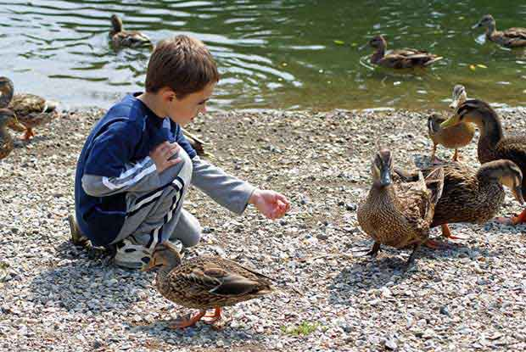
Background knowledge- IMPORTANT TO BUILD
READ
Explore
Go everywhere and TALK until your throat hurts!
Hulafrog (online website for local activities)
Bay State Parent monthly magazine
Local trips, everyday life activities

Slide 7
WHY? How is it related to learning and school?
Builds vocabulary = better speaking, writing and reading comprehension skills
Child is able to predict what may happen
Child will build inference skills needed for higher level thinking (details + background knowledge = Inference)
Knowledge of what is socially expected

Slide 8
QUICK ACTIVITY
1)Reading Comprehension - do you understand this? Why or why not?
Dramatic activity flourished in the late Middle Ages, from bawdy satires performed by traveling minstrels to expansive religious dramas that engaged the energies of an entire city to tell the story of the universe in 14 hours. Medieval literary and performance theory was not prepared for this explosion of drama. It had developed largely to grapple with the literary forms of the Bible and the performance of the Mass, and then to understand lyric and epic forms of poetry. Besides, Christian theology had often reacted to theater with hostility. Now that poets and clerics alike were embracing drama, literary theory had to adapt itself to explain a whole new genre.
2) Predict what will happen in Kat Kong based on your background knowledge of cats and mice

Slide 9
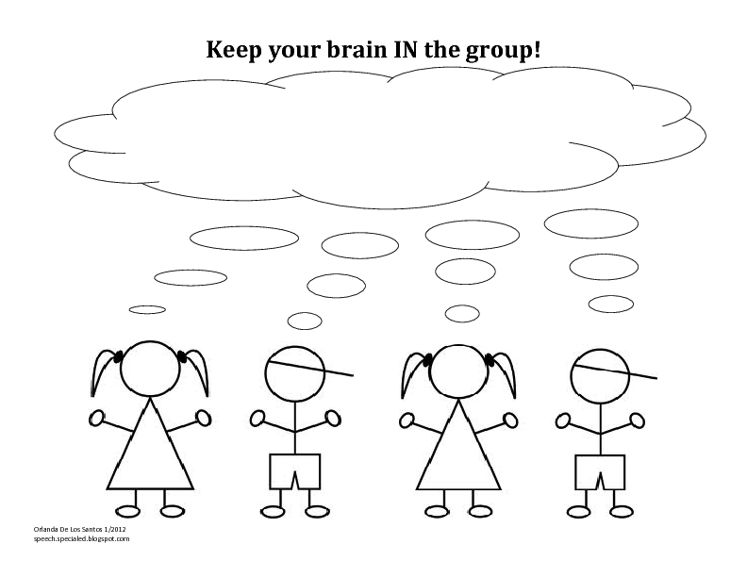
Social Thinking Terms Used At HOD and FK
GROUP PLAN and Social Behavior Maps
BEFORE going somewhere draw a quick GROUP PLAN - WE TIME vs ME TIME
Anytime we do something together we are following a group plan. Reinforce the idea that your child is following a plan when they are at home too. At home, group plans might include, cooking, eating dinner, swinging on the swings, going on a walk/bike ride, or going to Target.

Slide 10
Social Playdates
FroYo
Kids Place
Bowling
Wendys
Board Games- prep with social story if your child becomes upset with losing
Being together is being social

Slide 11
Questions?

